Slide 1
Introduction to Análise de Sistemas
TP01 · Course introduction and the software lifecycle (v2026-09-17)
Análise de Sistemas (ASis)
Licenciatura em Engenharia de Computadores e Informática
ico@ua.pt
2026/2027
Notes:
Welcome. This session covers what Systems Analysis and Design is, the lifecycles we will use, how AI agents change the work, and how the course runs. [TO CONFIRM: academic year and instructor names.]

Slide 2
Agenda
Why Systems Analysis and Design
Lifecycles: from the SDLC to DevOps and OpenUP
Engineering with AI agents: spec-driven development
The course: objectives, organisation and assessment
Working rules and next steps

Slide 3
Why Systems Analysis and Design
01
What the discipline is and why it matters

Slide 4
What is Systems Analysis and Design?
Business needs
Stakeholders, goals, business rules, constraints
Analysis — WHAT
Understand and specify in detail what the system must do: elicit, specify and validate requirements
Design — HOW
Define how the system will meet the requirements: architecture, models, technical plan
Technical solution
Software, data and infrastructure that deliver value
Systems Analysis and Design (SAD) bridges business needs and technical solutions. Analysis reduces uncertainty about the problem; design reduces uncertainty about the solution.
Notes:
Analysis: understand and specify what the system must do. Design: define how it will do it. The main goal is to bridge business needs and technical solutions.

Slide 5
Why should you care?
47%
of unsuccessful projects fail to meet their goals due to inaccurate requirements management.
PMI, Pulse of the Profession: Requirements Management (2014)
Complex projects need systematic methods. Intuition does not scale to many stakeholders, rules and integrations.
Requirements are where failure starts. Misunderstood needs are cheap to fix on paper and expensive in production.
Alignment. Keeps technical decisions tied to the goals of the organisation.
Guidance. Models and specifications guide development and integration — by people and by AI agents.
Notes:
Critical reading: survey-based figures such as PMI or the Standish CHAOS reports depend on how "failure" is defined; the Standish methodology in particular has been criticised. Use them as indicators, not as precise measurements.

Slide 6
Who does this work?
Key responsibilities
Requirements discovery — work with stakeholders to gather and determine needs
Analysis and specification — document functional and non-functional requirements clearly
Validation — check requirements against business goals and feasibility
Facilitation — build shared understanding between the organisation and technical teams
Change management — track changes and assess their impact
Where you will find it
Business analyst / systems analyst
Requirements engineer
Product owner
Solutions or software architect
Every developer who works with AI agents: someone has to write the specification
Notes:
The analyst is the bridge between stakeholders and the development team. See also Wiegers, "10 cosmic truths about software requirements".

Slide 7
Lifecycles: from the SDLC to DevOps
02
How software work is organised — and the framework we will use

Slide 8
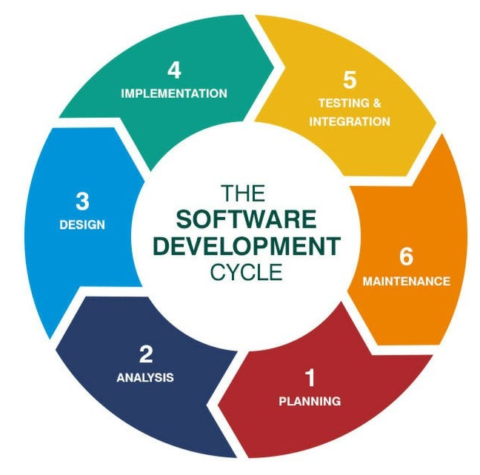
The Software Development Life Cycle (SDLC)
Planning
Analysis
Design
Implementation
Operation and maintenance
Scope, feasibility, resources, risks
Requirements and models of the problem
Architecture and technical plan
Construction, testing, deployment
Solutions in production evolve
Feedback from operation feeds new requirements
Every method reorganises these activities — sequentially, iteratively or continuously. None of them removes analysis and design.

Slide 9
Plan-driven vs iterative and agile
 | Plan-driven (e.g., waterfall, V-model) | Iterative and agile (e.g., UP, Scrum, Kanban)
Planning | Detailed plan up front | High-level plan, refined each iteration
Requirements | Specified and frozen early | Discovered and refined continuously
Delivery | One release at the end | Frequent working increments
Feedback | Late (testing, acceptance) | Early and continuous (demos, reviews)
Change | Controlled, expensive | Expected, prioritised in the backlog
Best fit | Stable, regulated, well-known problems | Uncertain or evolving needs
Table 1 – Two families of lifecycle models. Real projects often combine both.

Slide 10
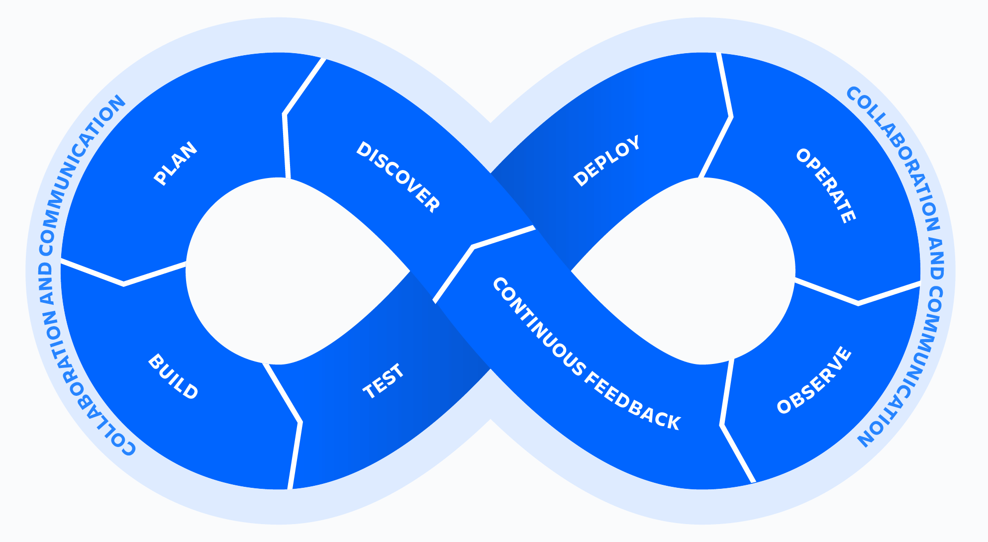
DevOps: closing the loop
Development
Plan
Code
Build
Test
Key practices
Continuous integration and delivery (CI/CD)
Automation of build, test and deployment
Observability of systems in production
Shared ownership between development and operations
Why it matters here: operation produces evidence that feeds analysis in the next cycle.
feedback becomes requirements
Monitor
Operate
Deploy
Release
Operations

Slide 11
OpenUP: our process framework
Inception
Elaboration
Construction
Transition
Milestone: Lifecycle Objectives
Milestone: Lifecycle Architecture
Milestone: Initial Operational Capability
Milestone: Product Release
Three levels of work
Core principles
Project lifecycle
months · phases and milestones
Collaborate to align interests and share understanding
Balance competing priorities to maximise stakeholder value
Focus on the architecture early to minimise risks and organise development
Evolve to continuously obtain feedback and improve
Iteration lifecycle
weeks · iteration plan, demo, retrospective
Micro-increments
hours to days · one work item at a time
OpenUP roles: Stakeholder, Analyst, Architect, Developer, Tester, Project Manager, Any Role.
Notes:
OpenUP is the open, lean version of the Unified Process, published through the Eclipse Process Framework (EPF). EPF is no longer actively developed [TO CONFIRM the date before citing it]; we use OpenUP as a reference model, not as a claim about current industry practice.

Slide 12
OpenUP and Scrum: a shared vocabulary
OpenUP | Scrum | Note
Iteration | Sprint | Time-boxed; ends with a working increment
Work items list | Product backlog | Prioritised list of everything still to do
Iteration plan | Sprint backlog | What the team commits to in this cycle
Analyst, Stakeholder | Product owner | Partial overlap: who represents needs and priorities
Project manager | Scrum master | Partial overlap: facilitation vs. planning
Phases and milestones | — | Scrum does not prescribe phases
Table 2 – Approximate correspondence between terms. The mappings are not one-to-one.

Slide 13
Engineering with AI agents
03
Agentic loops and spec-driven development

Slide 14
Agentic-enabled loop engineering
Specify
Human-led: intent, requirements, acceptance criteria
Generate
Agent-led: plan, code, tests from the specification
What changes
Loops get shorter: minutes instead of days
The specification becomes the main interface between people and agents
Verification becomes a first-class activity
Knowledge must be written down — agents only know what is in the repository
Humans own intent and acceptance. Agents accelerate execution.
Integrate and learn
Update specs, record decisions, plan the next loop
Verify
Humans and tools: review, tests, validation against the spec
"Loop engineering" is used here for designing iterative human–agent cycles; the term is not yet standardised.

Slide 15
Spec-driven development with OpenSpec
Explore
Clarify the idea; no commitment
Propose
Create a change: why, what, how, tasks
Apply
Agent implements the tasks
Archive
Merge spec deltas into the source of truth
openspec/
├── specs/ current truth:
│ what the system does
└── changes/
└── add-login/ one proposed change
├── proposal.md why and what
├── design.md how (UML welcome)
├── tasks.md checklist
└── specs/ requirement deltas
## ADDED Requirements
### Requirement: User login
The system SHALL authenticate
registered users.
#### Scenario: Valid credentials
- WHEN a user submits valid
credentials
- THEN the system grants access
OpenSpec (Fission-AI, MIT licence) works with 30+ coding assistants. Commands differ by tool and version; we will pin one version for the semester.
Notes:
Current OpenSpec workflow uses /opsx:* commands (explore, propose, apply, archive; expanded profiles add new, continue, ff, verify). Requirements are plain Markdown with WHEN/THEN scenarios. Check the exact syntax against the pinned version before class. Source: github.com/Fission-AI/OpenSpec

Slide 16
How it fits together: OpenUP × OpenSpec
Level | OpenUP | OpenSpec
Project | Phases: Inception → Elaboration → Construction → Transition | openspec/specs/ — the current specification of the system
Iteration | Iteration plan, work items | One or more changes per iteration
Micro-increment | A unit of work of hours to days | One loop: explore → propose → apply → archive
Roles | Analyst, Architect, Developer, Tester… | Humans specify and verify; the agent implements tasks
Requirements bridge
Use cases (OpenUP) ↔ requirements with WHEN/THEN scenarios (OpenSpec)
Models bridge
UML diagrams (PlantUML/Mermaid) inside design.md

Slide 17
Is Systems Analysis still relevant in the AI era?
Yes —
more than before.
The bottleneck moves. When code is cheap, the hard part is deciding what to build and checking it was built right.
Agents amplify ambiguity. Vague requirements now produce plausible but wrong systems — faster.
Specifications become input. Precise requirements are directly consumed by agents.
Accountability stays human. Quality, security, privacy (GDPR) and regulation (EU AI Act).
Traceability matters. Requirement → change → code → test.

Slide 18
Mind the soft skills: analysis is human-interaction work
01
Listening and elicitation
Interviews, workshops, observation
02
Communication
Write and draw for different audiences
03
Negotiation
Balance competing priorities
04
Facilitation
Align stakeholders; run productive sessions
05
Teamwork
Share the process, not just the tasks
06
Critical thinking and ethics
Question assumptions — including AI outputs

Slide 19
The course
04
Objectives, organisation and assessment

Slide 20
Learning objectives
By the end of the course, you should be able to:
Explain SDLC practices and methods in information systems projects
Participate in eliciting, documenting and analysing requirements
Apply system modelling techniques, especially UML
Identify constraints that shape the technical architecture
Manage a project with agile practices: boards, iterations, user stories
Apply spec-driven development with AI agents, keeping specifications traceable
New in this edition
Spec-driven development with OpenSpec
An explicit course policy for AI use, aligned with the UA framework
Notes:
[TO CONFIRM] Objective 6 is new and should match the official course description (ficha da UC).

Slide 21
Mapping to the SWEBOK Guide v4.0
Knowledge area | Coverage | Where in ASis
Software Requirements | Core | Elicitation, specification, validation
Software Engineering Models and Methods | Core | UML modelling, OpenUP, spec-driven development
Software Engineering Process | Core | SDLC, agile, DevOps, OpenUP
Software Design | Core | Design models, design.md
Software Architecture | Introductory | Architectural constraints and views
Software Engineering Management | Partial | Iteration planning, boards, estimation
Software Quality | Partial | Acceptance criteria, requirements validation
Software Eng. Professional Practice | Partial | Soft skills, teamwork, ethics
Software Construction · Testing | Supporting | Project increments built and tested with agents
Table 3 – Knowledge areas of the SWEBOK Guide v4.0 (IEEE Computer Society, 2024) addressed in ASis. The guide defines 18 areas.
Notes:
[TO CONFIRM] Coverage levels are a proposal; adjust to the course plan.

Slide 22
Semester roadmap
Inception
Elaboration
Construction
Transition
U1 · Lifecycles and processes
U3 · Use cases and behaviour modelling
U6 · Spec-driven construction with agents
U7 · Validation, delivery and retrospective
U2 · Requirements elicitation and specification
U4 · Domain and structural modelling
U5 · Architecture and design
Units follow the OpenUP phases of the group project. Dates and deliverables: see the calendar on Moodle.
Notes:
[TO CONFIRM] Thematic units are a draft derived from the learning objectives; align names and order with the official calendar.

Slide 23
How classes work
Lectures (TP): concepts, methods and discussion.
Labs (P): some reparatory learning activities, but mainly group project development.
End of each thematic unit: team presentation of results.
Moodle is the entry point: announcements, calendar, resources and submissions. Additional tools will be used (JIRA, GitHub,…)

Slide 24
The group project
DRAFT plan for an agentic-supported iteration
1
Plan the iteration
2
Specify (OpenSpec change)
3
Build with an agent
4
Verify against the spec
5
Demo and retrospective
You will deliver
Requirements and UML models
Specifications and change history (OpenSpec)
Working increments of the system
Lab portfolio
Tools
Git repository shared by the team
Project board for work items
OpenSpec (version announced on Moodle)
An AI coding assistant supported by OpenSpec
Notes:
[TO CONFIRM] Team size, project theme and the specific AI assistant(s) allowed.

Slide 25
Assessment
Component | Weight
TP — written exam (exam period) | 40%
P — group project | 45%
P — Homework portfolio (individual) | 15%
Minimum grade: 7 out of 20 in each component (TP and P).
Attendance is recorded in TP classes (for monitoring purposes).
Notes:
Weights kept from the 2024/25 edition. [TO CONFIRM] against the official course description.

Slide 26
AI in this course
University of Aveiro framework
Referencial para Avaliação das Aprendizagens na Era da Inteligência Artificial (approved July 2026)
A learning-centred approach
Rejects a logic of prohibition or detection
Promotes intentional, transparent use of AI, aligned with the competences being assessed
Our rules
AI agents are part of the project method, through the OpenSpec workflow
Declare which tools you used and for what
You are accountable for every artefact you submit — and must be able to explain it
Specifications and models are assessed on their own quality, not only the final product
For the written exam: individual competences without AI
Notes:
[TO CONFIRM] The course rules are a draft proposal. Check them against the full UA framework and its guidance (ua.pt/pt/inovacaopedagogica/referencialia).

Slide 27
Pitfalls to avoid in group work
01
Splitting tasks and skipping the discussion
Everyone must go through the process — that is where learning happens.
02
Letting the "dedicated volunteer" carry the team
Free-riding hurts the team and the individual assessment.
03
Accepting agent output without review
Plausible is not correct. You own what you submit.

Slide 28
Resources
On Moodle
Announcements
Class calendar and plan
Lab programme and deadlines
Thematic units (tab inside the calendar)
Recommended bibliography
References
Dennis, Wixom & Roth — Systems Analysis and Design (Wiley)
Larman — Applying UML and Patterns (Prentice Hall)
Wiegers & Beatty — Software Requirements (Microsoft Press)
IEEE Computer Society — SWEBOK Guide v4.0 (2024)
OpenUP — Eclipse Process Framework
OpenSpec — github.com/Fission-AI/OpenSpec
Notes:
[TO CONFIRM] References should match the official bibliography of the course; editions omitted on purpose.

